Slide 1
Assignment 5
Part A : CNN Part B : NL to SQL

Slide 2
Overview
This assignment explores two core AI concepts:
Deep learning model design using Convolutional Neural Networks (CNNs)
Prompt engineering with Large Language Models (LLMs)
Goals:
Study how architectural and regularization choices affect CNN performance
Evaluate how prompt design impacts LLM-generated SQL accuracy

Slide 3
CNN Modeling Setup
Dataset: CIFAR-10 (10-class image classification)
Framework: TensorFlow / Keras
Input: 32×32 RGB images
Output: Softmax probability over 10 classes
Experiments varied:
Batch Normalization and Dropout
Number of Conv + Pool blocks (depth)
Activation function (ReLU vs ELU)
Training constraints:
CPU-only environment
Small data subset
Limited epochs

Slide 4
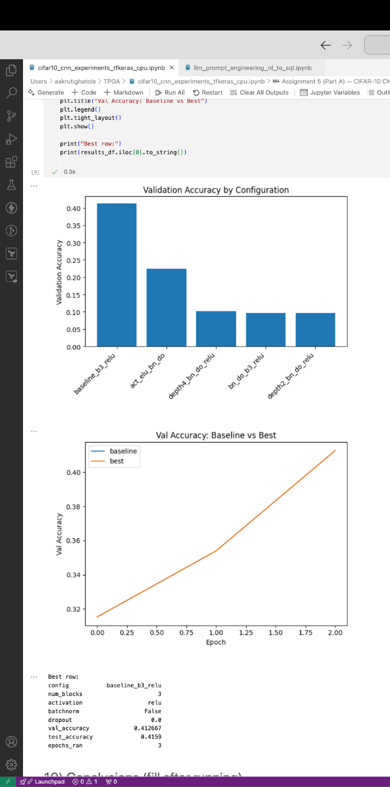
CNN Results and Key Insights
Baseline CNN (3 blocks, ReLU, no BN/Dropout) achieved highest validation accuracy (~0.41)
Batch Normalization and Dropout reduced short-term performance due to underfitting
Deeper CNNs (4 blocks) performed worse under limited data and epochs
ELU activation slightly outperformed ReLU among regularized models
Key takeaway:
Regularization and depth improve generalization only with sufficient data and training time
Simpler models can outperform complex ones in constrained settings

Slide 5
Natural Language to SQL with LLMs
Objective:
Translate a natural language query into SQL using an LLM
Database schema:
Customers
Orders
OrderItems
Query requirement:
Must involve at least two tables (JOIN)
Include aggregation and sorting
Example NL Query:
“Show each Boston customer’s name and their total spending across all orders”

Slide 6
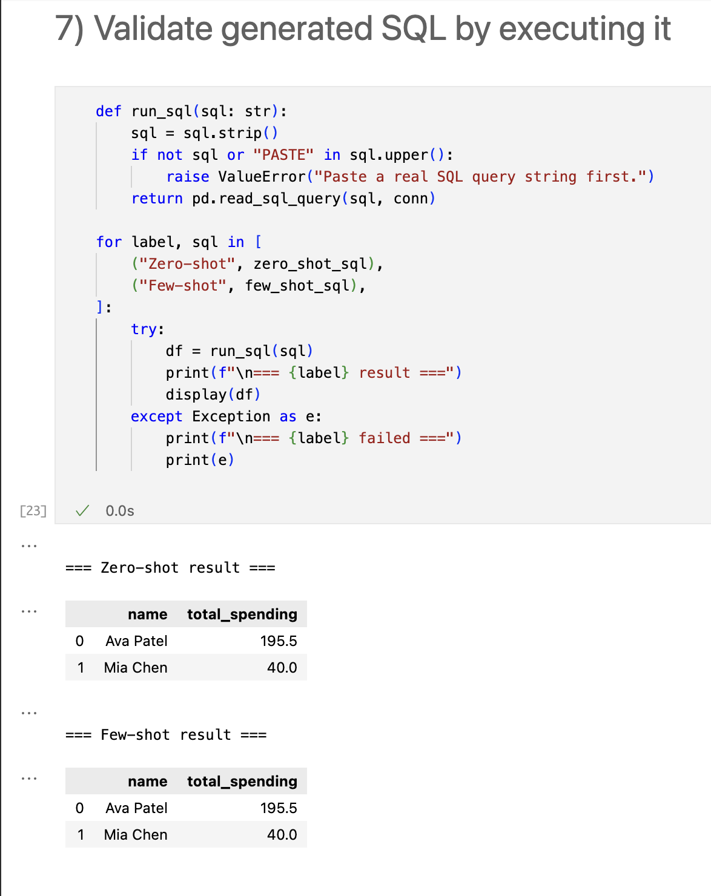
Prompt Engineering Comparison
Zero-shot prompting:
Generated correct SQL for this query
Included JOIN, filtering, aggregation, and sorting
Few-shot prompting:
Produced the same correct SQL
More reliable for complex queries
Generated SQL was executed on SQLite database to verify correctness
Key insight:
Prompt engineering improves robustness and consistency
Few-shot prompting is preferable for real-world schemas

